Slide 1
Object Oriented Programming in Python: Inheritance

Slide 2
Today’s Goals
Provide an introduction to inheritance in OOP.
  Why and when should we inherit from other objects?
  How do we inherit from objects in Python?
2. Provide an introduction to method overriding.

Slide 3
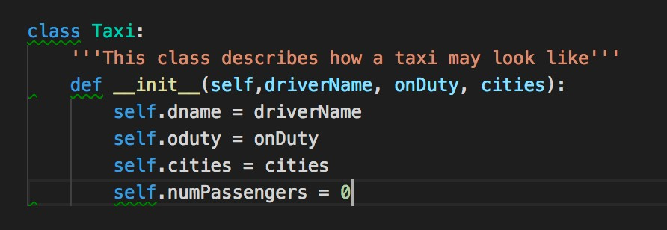
From Last Time

Slide 4
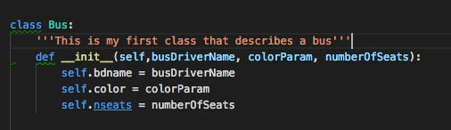
From Last Time (cnt.)

Slide 5
Comparing Bus & Taxi

Slide 6
Comparing Bus & Taxi
Classes share similar variables

Slide 7
Inheritance
Inheritance simplifies our code through reuse of the code that has been already written.
  Think about the Taxi and Bus, and what they have in common.
Inheritance is a relation between a parent class (e.g. Vehicle) and children classes
(e.g. Taxi, Bus, Truck, etc.)
A class inherits attributes and behavior methods from its parent classes.

Slide 8
Taxi
Bus
DriverName NumberOfWheels NumberOfSeats OnDuty
DriverName
NumberOfWheels
NumberOfSeats
Color

Slide 9

Taxi
Bus
DriverName NumberOfWheels NumberOfSeats OnDuty
DriverName
NumberOfWheels
NumberOfSeats
Color
Wait, we wrote the same three lines of code in both classes? There must be a better way!!!

Slide 10
Vehicle
DriverName NumberOfWheels NumberOfSeats
We moved the commons in a parent class
Taxi
Bus
OnDuty
Color
The child classes only keep the attributes and methods relevant to them

Slide 11
OOP Inheritance in Python
Create a parent class (e.g. Vehicle) with the common attributes and
common methods.
Create child classes (e.g. Bus and Taxi) with the extended attributes
and extended methods.
  Pass the class definition to the child (e.g. Class Bus(Vehicle): …)
  Use the parent attributes and methods through super().

Slide 12
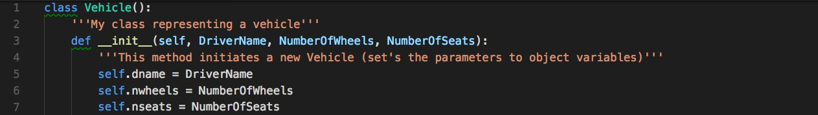
In Python code

Slide 13
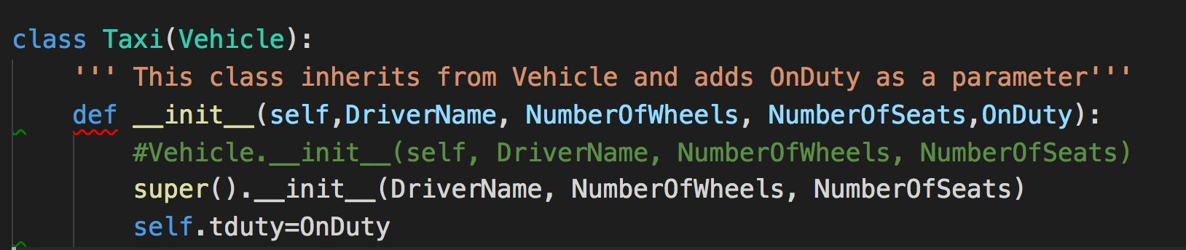
In Python code

Slide 14

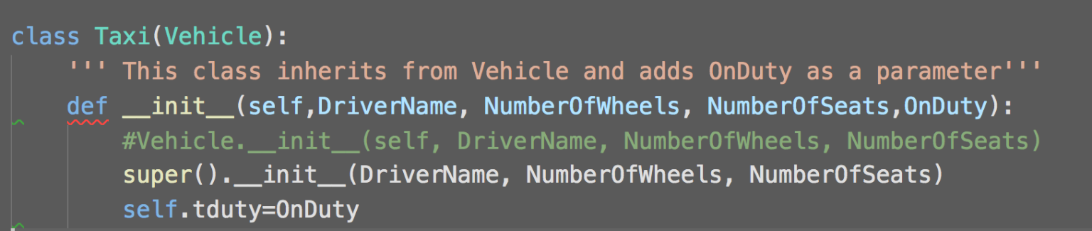

In Python code

Slide 15


In Python code

Slide 16

In Python code

Slide 17
Exercise time!
Model the following problem in Python code:
Frida Jacobsson is a student at MAH. Her Skype nickname is frida96.
Aleksander Fabijan is a researcher at MAH. He teaches DA712 and DA374.
They are both Humans.

Slide 18
Exercise time!
Model the following problem in Python code:
Frida Jacobsson is a Student at MAH. Her Skype nickname is frida96.
Aleksander is a Researcher at MAH. He teaches DA712 and DA374.
They are both Humans.
Suggestion:
1) Create a class Human that initiates a new human with a name.
Next, create two classes (e.g. Student and Researcher) that inherit from human,
2)
3) Finally, add the skype nickname and the list of courses to the new classes.
Code snippets for help:
class Taxi(Vehicle):
super(). init (name, lastname)
#creates a child class from Human
#calls the parent’s init method

Slide 19
LC

Slide 20
Method Overriding
Method overriding is an object-oriented programming feature that allows a subclass to provide a different implementation of a method that is already defined by its superclass or by one of its superclasses.
init in the child class (e.g. Taxi) overrides the init method from the parent class.

Slide 21
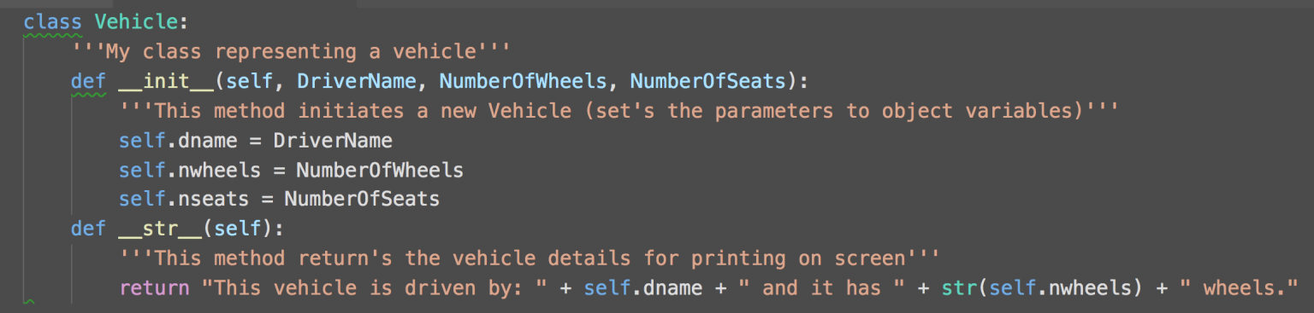
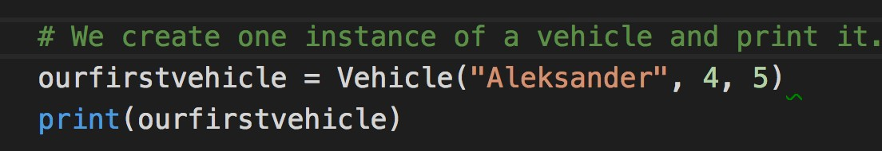
Example of overriding str
Let’s add a str method that nicely prints our Vehicle details on the screen.
Output:

Slide 22

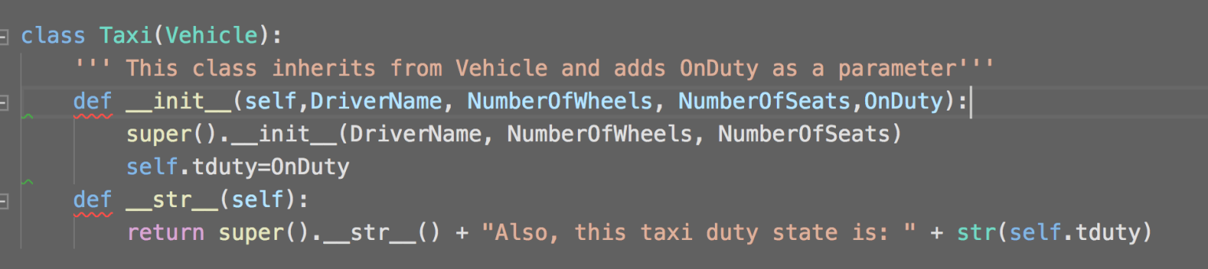
Example of overriding str

Slide 23
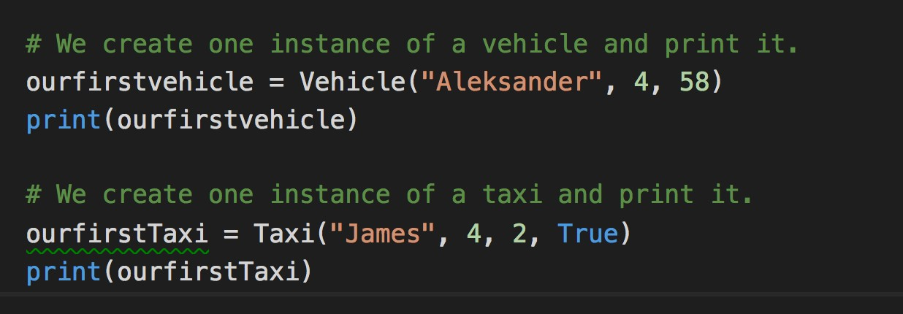
Example of overriding str

Slide 24
Exercise Time
Part1: Update your class Human with a str method that can be used on print. It should return the name and lastname of the human. Try it out by creating one human in code.
Part2: Update your class student and class researcher by overriding the str method.
str in the child classes should use super().__str (args) to call its parent method to print out the name and lastname.
Part3: For student, override the str (args) method so it returns in addition to the name and lastname, also the skype nickname. Do the same for the researcher with his phone extension.

Slide 25
Takeaways
Today, we learned how and when to use inheritance in python OOP.
Whenever our classes can reuse the attributes and methods from parent classes.
We inherit from parent classes by passing their name as a parameter to our child class.
We reuse the methods and attributes from parent classes by using super().
We also learned how to override methods in python.

